Slide 1
UE18CS334 –NLP Project Phase – 1
Project Title : English to Kannada Translator
Team ID : 18
Project Guide : Dr. Mamatha H.R.
Project Team : Shree Akshaya A T – PES120181466
Shruthi Shankaran – PES120181677
H M Thrupthi – PES120181987

Slide 2
Agenda
Problem Statement
Abstract and Scope
Literature Survey
Design Constraints
Proposed Methodology / Approach
Technologies planning to Use
References

Slide 3
Problem Statement
English to Kannada Translator
The main objective of this topic is English to Kannada sentence translation using neural networks.
Kannada or Canarese is a language spoken in India predominantly in the state of Karnataka, making it the 25th most spoken language in the world. It has given birth to so many Indian languages like, Tulu, Kodava etc one of the scheduled languages of India and the official and administrative language of our native state Karnataka. So our main objective of this project is to build neural machine translation for English to Kannada, which would help the native kannada people who aren’t familiar with english.

Slide 4
Abstract
Kannada Language being the major Dravidian languages of India and it has 25th place in most spoken language in the world. For low resource languages like kannada the translation is not much explored, still translation models uses the statistical approaches, rule-based approach, example-based approach, phrase based approach etc. But there is lot of advancement in the field for machine translation like using the neural machine translation, transformers like BERT model that makes the translation more efficient and accurate which is explored in other languages .
Therefore the aim of our project is to deals with sentence translation from english to Kannada using neural networks.

Slide 5
Scope
Any application involving English text to Kannada text translation (Ex.web articles in English).
The project involves in translation using English-Kannada Bilingual corpus.
Can be extended to summarization of article in english, then translation to kannada.
Our goal is to give complete meaningful, coherent and efficient translated sentence from english to Kannada.

Slide 6
Feasibility study
Finding high quality, large scale dataset(s) for two languages.
Kannada is not as widely used as English, hence references are few.
Dealing with different structures in both language i.e., English as SVO where as Kannada has SOV structure.
Preprocessing of given English sentence.
Since one word can have multiple similar words in other language, so selecting most probable word would be a challenge.
i.e., Ambiguity.
Arriving at meaningful translations.

Slide 7
Applications/Use cases
System would be applicable for translation from source language to desired language, which would solve the interpretation problem of those who don’t know the source lang.
A reliable English to Kannada translator will be very useful for various web applications that require to be in Kannada for native speakers who do not know English, for example study resources on the net, official documents, news articles.

Slide 8
Literature Survey
Research over the topic has been done by referring the following papers.
Machine Translation for English to Kannada [1]
POS Tagger for Kannada Sentence Translation[2]
3. On the use of BERT for Neural Machine Translation[3]
4. Indic Language Machine Translation Tool for NLP [4]
5. Incorporating BERT into NMT [5]
6. Improving the Transformer Translation Model
with Document-Level Context [6]

Slide 9
Works focused on improving the analysis on the given ------to get better results.
Paper 1: Machine Translation for English to Kannada
Year of Publication: 2011
Authors: Mallamma V Reddy, Dr. M. Hanumanthappa
Data: Here the dataset has been created by the authors itself. And they haven’t mentioned the source of dataset.
Summary: The whole paper deals with machine translation process for English to Kannada translation. Also Interlingual language as an intermediate form between two or more languages. In this paper they have explained the concepts and algorithms presented while implementing Bilingual Translation System for English to Kannada/Telugu which translates given input sentence in source language into target language using hybrid approach(Rule based method + example based methods).
Cross Language Information Retrieval Tool is built by using the ASP.NET as front end and for a Database the Kannada is encrypted by using the Encoding system.

Slide 10
Methodology proposed/implemented in the paper
The following approach is designed to produce an system in translating English into Kannada/Telugu by using the 4 basic sentence patterns as a template. The outline of the system is as follows:
1. Morphological analysis : An input sentence is first segmented into a word, written English sentences are automatically segmented, i.e, each word is separated by a pause or space, then analyzed morphologically into a morpheme (in the form of a stem or root ) by applying morphological analysis rules .
2. Pattern mapping : In Pattern mapping or transfer between the two languages involved a few steps.
First, an English input sentence is syntactically analyzed into a series of non-terminal symbols (NP, VI, VT, ADJ, etc.).
This string will be checked with the table of E-K sentence pattern mapping .
If the pattern of input sentence is identical to any pattern of English, it will be mapped to the Kannada/Telugu sentence pattern that is correspondent.
3. Looking up bilingual dictionary : The bilingual dictionary of 10,000 entries is created in dbase format and looked up for mapping Kannada/Telugu equivalent entries onto the input string. Then a Kannada/Telugu output sentence is generated.

Slide 11
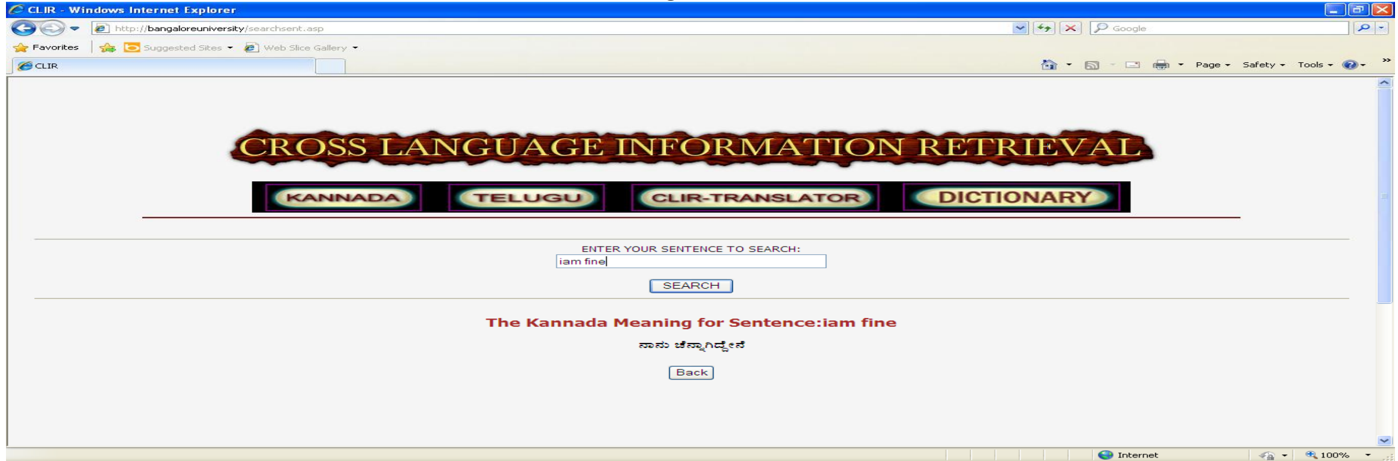
Methodology proposed/implemented in the paper
4. Possible Combinations : In this step the statistical method is used to calculate the probabilities of word that should be translated. It involves steps as follows:
Search through the statistical data stored and pick out the most likely word for translation.
With this method, elimination of a large number of possible combinations or candidate sentences is done.
The output sentences that are ambiguous or have nonsensical meaning will be deleted as much as possible.
After that the output sentences is stored as raw data for further applying an example-based method.
Sample result for English-Kannada for Sentence Translation by this model implemented in the paper

Slide 12
Merits and Demerits of the proposed method in the paper
Merits :
They have solved the ambiguity problem using statical modeling.
Translation requires not only vocabulary and grammar but also knowledge gathered from past experience. They have approached this by storing the output of every translation for the future use.
They have implemented for both Kannada and Telugu simultaneously.
The hybrid model (rule-based + example based methods) implementation has helped them to get more accurate results.
Demerits :
One of the major challenge in Bilingual Machine translation is handling the different structures of languages. Here English has Subject Verb Object (SVO) structure while Kannada has Subject Object Verb (SOV) structure this has been unraveled by this paper.
Notes:
Images are represented as graphs and interactions between objects are capture by a graph attention mechanism.

Slide 13
Works focused on improving the analysis on the given ------to get better results.
Paper 1: POS Tagger for Kannada Sentence Translation
Year of Publication: 2012
Authors: Mallamma V Reddy, Dr. M. Hanumanthappa
Data: BUBShabdasagar-2011 Machine Readable Dictionary (MRD)
Summary: This paper highlights the process of text preprocessing, translation of English to Kannada and then generating and implementing Phrase Structure Grammar (PSG) for Kannada sentences. Part of speech tagging plays a vital role in natural language processing. This paper presents a reasonably accurate POS tagger for Kannada language.
Part of Speech(POS) tagging helps in the creation process of a parser. In future it can also use this parser for tree to tree translation. This will be very useful for bilingual machine translation from English to Kannada language.They have used Part-Of-Speech (POS) tagger generator for assigning proper tags to each and every word in the training and test sentences. The precision of this POS tagger system is measured in terms of percentage i.e. the percentage of words, which are accurately tagged by the tagger.

Slide 14
Dataset
BUBShabdasagar-2011 Machine Readable Dictionary (MRD)
The dictionary was available in the ISCII character encoding form and in the plain text format. The entries were converted into UTF-8 encoding. The English→Kannada bi-lingual dictionary has around 14,000 English entries and 40,000 Kannada entries.

Slide 15
Methodology proposed/implemented in the paper
The task of Part of speech (POS) tagger is simply assigning a part of speech to a word. Each word is a noun, adjective, verb or any one of the other parts of speech. The following approach is designed to produce system of POS tagger for Kannada Sentence translation.
Text Preprocessing : It involves five text operations:
1. Lexical analysis categorizes a text into digits, hyphens, case of letters and punctuation marks.
2. Elimination of stop words.
3. Stemming of the remaining words with the objective of removing affixes (i.e., prefixes and suffixes) and allowing the retrieval of documents containing syntactic variations of query terms (e.g., connect, connecting, connected, etc)
4. Selection of index terms to determine which words/stems (or groups of words) will be used as an indexing element.
5. The categorization structures construction.
Translation : Machine translation is the process of translating from source language text into the target language. they have implemented the above for machine translation using ‘BUBShabdasagar-2011’ MRD as a translation lexicon resource for our research. The dictionary was available in the ISCII character encoding form and in the plain text format. The entries were converted into UTF-8 encoding. The English→Kannada bi-lingual dictionary has around 14,000 English entries and 40,000 Kannada entries.

Slide 16
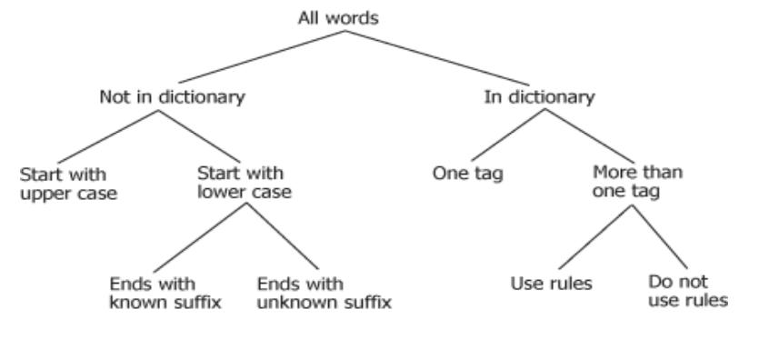
Methodology proposed/implemented in the paper
3. Parsing : Syntactic analysis phase where the analyzing a text or sentence that is made up of a sequence of words called tokens, and to determine its grammatical structure with respect to a given grammatical rules then tag the token with proper POS.
4. Phrase Structure Grammar For Kannada : They use a decision tree model to explain rule-based tagging.
At the top of the tree all are untagged words, For every word, we traverse s path through a tree till a leaf node. Each node in the tree corresponds to an attribute. The attribute value of a word determines the path from the root to a leaf node. The first attribute at the root node is a flag to indicate whether the word exists in the dictionary. Words that occur in the dictionary can have one or more tags
Decision tree to assign POS tags

Slide 17
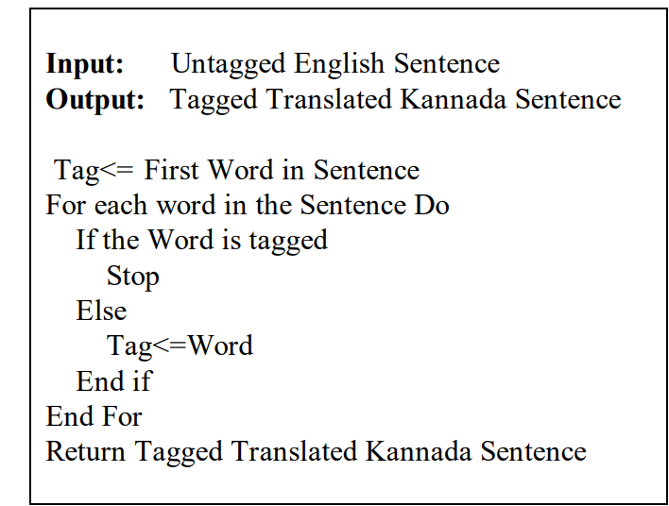
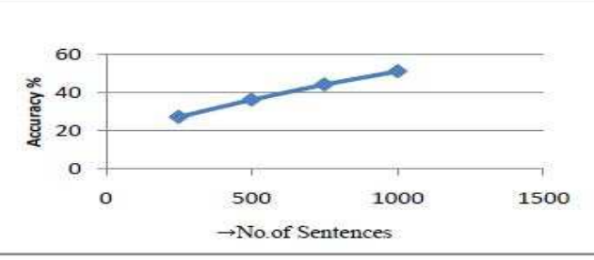
Methodology proposed/implemented in the paper
Algorithm: POS tagging used in the model
Results and Performance
They have trained the systems with corpus size of 500, 1000 and 1500 sentences respectively for POS tagging. Performances of the systems were evaluated with the same set of 500 distinguished sentences that were out of corpus. From the experiment they found that the performances of system are significantly well and achieves very competitive accuracy by increasing the corpus size
Performance Graph

Slide 18
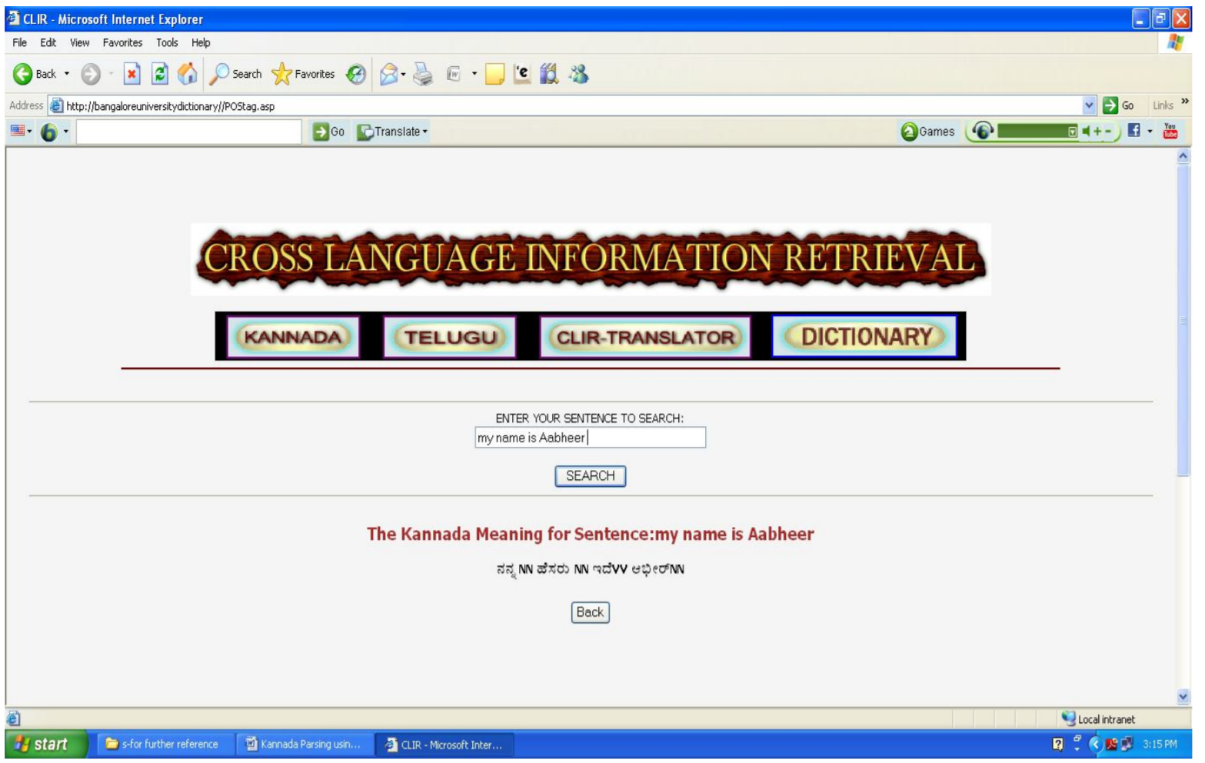
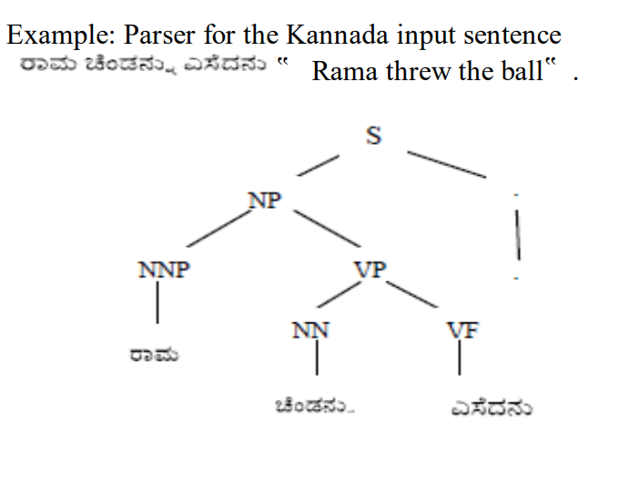
Methodology proposed/implemented in the paper
Results and Performance
Example of a Parser tree structure

Slide 19
Merits and Demerits of the proposed method in the paper
Merits :
This paper highlights the process of text preprocessing, translation of English to Kannada and then generating and implementing Phrase Structure Grammar (PSG) for Kannada sentences.
They have repeatedly trained the system by increasing the number of sentences respectively for POS tagging that helped them to increase the accuracy of the system by increasing corpus size.
Demerits :
English has Subject Verb Object (SVO) structure while Kannada has Subject Object Verb (SOV) structure this has been unraveled by this paper.

Slide 20
Works focused on improving the analysis on the given ------to get better results.
Paper 3: On use of BERT for Neural machine translation
Year of Publication: 2019
Authors: Stephane Clinchant, Kweon Woo Jung, Vassilina Nikoulina
Data: WMT-14(English-German), IWSLT15(English-German), IWSLT14(English- Russia)
Summary: The main aim of this paper is explore on the approaches on how the BERT pretrained model can be exploited for a supervised Neural machine translation and to evaluate the robustness of the model by doing out-of -domain test set and noise injected test set.
In this paper they compare various ways like the like Baseline, Embedding, Fine-tuning , freeze models were considered to integrate pretrained BERT model with Neural machine translation. The training of BERT model is done 3 different monolingual corpora of different size and domain. So using this pretrained model 2 experiments where consider (1)training using the WMT-14 data (2)reusing the model from the previous and then train with IWSLT dataset. The model was evaluated based on BLEU score for in-domain test set. In order to evaluate the robustness(in terms of out-domain test set and noise in the input) charf scores in addition to BLEU score.

Slide 21
Dataset
Training for neural machine translation:- WMT-14(English-German), IWSLT15(English-German), IWSLT14(English- Russia)
Training the BERT model :- NMT-src corpora, Wiki corpora, News dataset

Slide 22
Methodology proposed/implemented in the paper
In this paper a pre trained BERT model is used in order to inject prior knowledge on the encoder part of NMT, providing a rich embedding learned from large monolingual corpus.
The model considered for comparing
Baseline:- Transformer-big model with share decoder input-output embedding parameters
Embedding:-The baseline model where the embedding layer is replaced by the BERT parameters.
Fine-Tuning :- The baseline model with the encoder initialized by BERT parameter
Freeze:- The baseline model with the encoder initialized with BERT parameter and frozen
They have done 2 experiments :-
WMT dataset
Preprocessing:- use byte-pair encoding(BPE) on the source side and target side.
Training:- BERT 3 monolingual corpora of different size and different domain was used. The masked LM task for BERT was considered for experiments(15% tokens masked). Training of BERT model up to 200k iteration until the masked LM accuracy was saturated. For NMT training was done using WMT dataset by using transformer Big model(Baseline model) ,where it share the input embedding and output embedding parameter.
Evaluation:- Based on BLEU score for in-domain test sets. In order to check the robustness of the model noise like typos and UNK token was introduced in the data for this along with the BLUE score the sentence charf score between original data and noisy data was also considered.
Results:- BERT+NMT architecture improves over the baseline model both on in-domain anf out-domain test sets.Robustness test shows that that there iss no improvement in model when the UNK tokens was included which leads to poor translation quality.

Slide 23
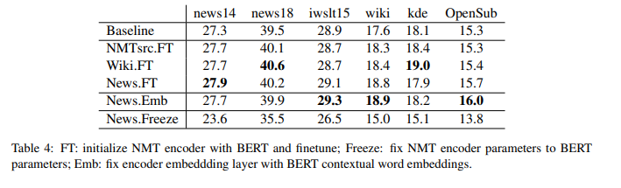
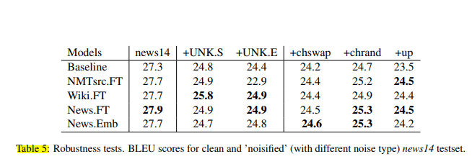
Methodology proposed/implemented in the paper
Results on translation on different model
Robustness result
2) IWSLT dataset
The experiment they have reused the pretrained BERT model from the previous experiments and then used that for train IWSLT using the BERT model. Few configuration as been done on IWSLT baseline like changes in BPE on source side and target side. In this case the transformer base architecture was used as baseline model.

Slide 24
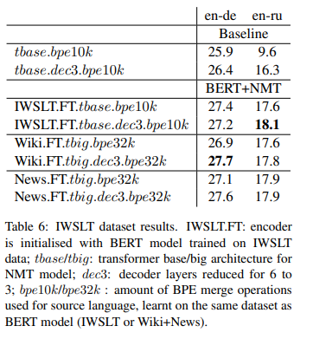
Methodology proposed/implemented in the paper
Result:- BERT pretrained model improves over the baseline, in any setting of BPE.

Slide 25
Merits and Demerits of the proposed method in the paper
Merits
By using pretrained BERT model it solves a monolingual task of source sentence encoding
using pretrained BERT model there is possibility to exploit much on larger data
mainly focus on better initialization of parameter on encoder with BERT pretrained LM which allow faster NME learning
Explores test on the Robustness of the model
Demerits
The test robustness does not improves when UNK token are introduced in the data set . This leads poor translation quality.

Slide 26
Works focused on improving the analysis on the given ------to get better results.
Paper 4: Indic Language Machine Translation Tool for NLP
Year of Publication: 2013
Authors: Mallamma V Reddy , Dr. M. Hanumanthappa
Data: machine-readable bi-lingual Kannada→English and Telugu→English dictionaries created by BUBShabdasagar
Summary: The paper deals with the translation system from English to kannada/telugu and vice-versa. So for the translation model 2 modules where considered (1) Language identification (2)Transliteration (3) Translation. In this paper the approaches are based on the Query Translation using bi-lingual dictionaries .The approaches for translation is Based on Dictionary based approach and Rule based approach. And the performance of the translation is evaluated based on the precision and recall rates at the word.

Slide 27
Dataset
To train for language identification:- dataset of 100 text lines from each of the 3 languages (English,kannada,Telugu)
Translation :- machine-readable bi-lingual Kannada→English and Telugu→English dictionaries created by BUBShabdasagar

Slide 28
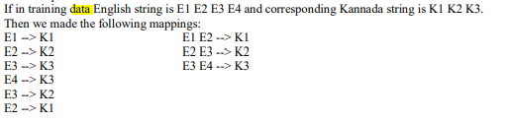
Methodology proposed/implemented in the paper
Language Identification:- For this the unigram statistical approaches was considered in order to identify languages which was trained with dataset of 100 text lines from each of the 3 languages
Transliteration
In machine transliteration the conversion of characters or word from one language to another without losing the meaning of the phonological characters. For the converting process noth graphemes and phoneme information was considered. The Dictionary for transliteration was constructed with the help of the training data set the possible maps the characters between english and kannada

Slide 29
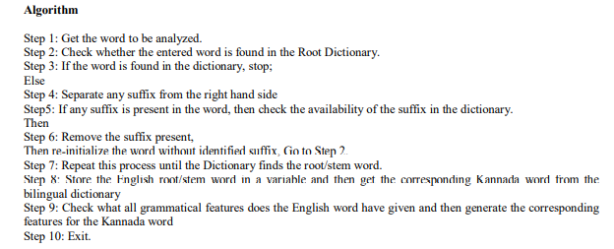
Methodology proposed/implemented in the paper
Translation
Morphological Analyser:-
As kannada/telugu are morphologically rich ,therefore the stemming of the query word is done initially before looking in bilingual dictionary. Hence the Morphological analysis is done where their determines the word form such inflection, tense,number, parts of speech etc.
The algorithm used for morphological analyzer

Slide 30
Methodology proposed/implemented in the paper
Dictionary based approach:- In the traditional dictionary based approach there is ambiguity in translation query words. In order to solve this the, strategy of translation selection by exploiting word and co-occurrence pattern.In this paper the similarity measurement considered between translation word is defined in the form word co-occurrence statistics. But there will be set of possible words for a particular translation come into picture, therefore the a greedy algorithm is consider in order to find the best word for translation .
The greedy algorithm used :- : Given a set of m original query terms {a1,…, an}, we first determine a set Ti of translation words for each ai through the dictionary. Then we try to select the word in each Ti that has the highest degree of cohesion with the other sets of translation word.
Rule based approach:- Initially the process of analyzing input sentence of a source language morphologically, syntactically, semantically and thern generation of output sentence of the target language based on an internal structure. In this approach each step is controlled by dictionary and rules

Slide 31
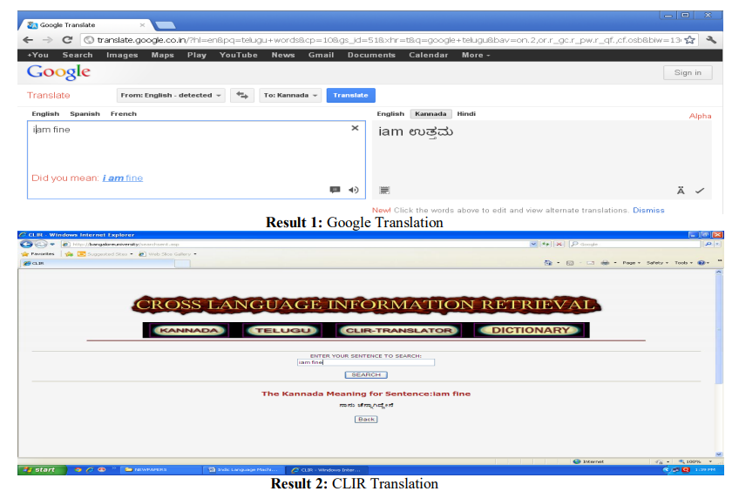
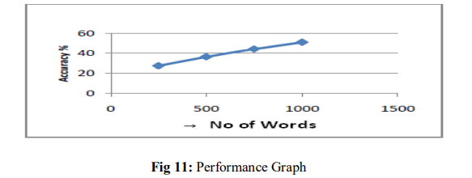
Methodology proposed/implemented in the paper
Result:-
Comparison between the google translation and the model
Evaluation was based on the precision and recall rates at the word. The accuracy increases as the corpus size increase.

Slide 32
Merits and Demerits of the proposed method in the paper
Merits:-
Solved the ambiguity problem by using the similarity measure and cohesion
Demerits
Kannada has Subject Object Verb (SOV) structure in Machine translation need to be solved by using morphology of Natural Languages.
Translation doesn’t focus more on the semantic structure to make a better precise translation.
Query translation is that queries are often short and short queries provide little context for disambiguation.

Slide 33
Works focused on improving the analysis on the given ------to get better results.
Paper 5: INCORPORATING BERT INTO NEURAL MACHINE TRANSLATION[5]
Year of Publication: 2020 (ICLR 2020)
Authors: Jinhua Zhu, Yingce Xia, Lijun Wu, Di He, Tao Qin, Wengang Zhou, Houqiang Li, Tie-Yan Liu
Data: IWSLT’14 English-German, English-Spanish, IWSLT’17 English-French and English-Chinese translation.
Summary: Uses BERT fused model, i.e. extract representations for an I/p sequence using BERT, fused with each layer of encoder and decoder through attention techniques. Includes supervised, unsupervised and semi-supervised.

Slide 34
Dataset
https://github.com/bert-nmt/bert-nmt/tree/master/examples/translation
-Conduct 14 experiments on various NMT tasks to verify our approach, including supervised,
semi-supervised and unsupervised settings
-Eng to French, Eng to German, Romanian to Eng
Notes:
Task Directed Image Understanding Challenge (TDIUC) is a new dataset that divides VQA into 12 different question types that makes it easier to measure and compare the performance of VQA algorithms. TDIUC also contains unanswerable/absurd questions.

Slide 35
Methodology proposed/implemented in the paper
-Exploit the representation from BERTby feeding it into all layers rather than served as input embeddings only
-An input sequence is first transformed into representations processed by BERT (pretraining). Then, by the BERTencoder attention module, each NMT encoder layer interacts with the representations obtained from BERT and eventually outputs fused representations leveraging both BERT and the NMT encoder.
The decoder works similarly and fuses BERT representations and NMT encoder representations.
-Use the attention mechanism to adaptively control how each layer interacts with the representations, and deal with the case that BERT module and NMT module might use different word segmentation rules, resulting in different sequence (i.e., representation) lengths. Compared to standard NMT, in addition to BERT, there are two extra attention modules, the BERT-encoder attention and BERT-decoder attention.
Notes:
Then, by the BERTencoder
attention module, each NMT encoder layer interacts with the representations obtained from
BERT and eventually outputs fused representations leveraging both BERT and the NMT encoder.

Slide 36
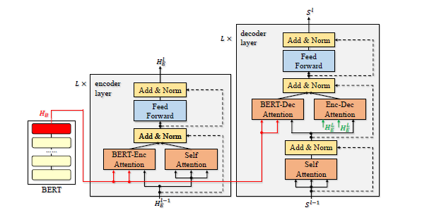
Methodology proposed/implemented in the paper

Slide 37
Methodology proposed/implemented in the paper
RESULTS:
For supervised NMT, we work on five tasks of IWSLT datasets and two WMT datasets. Specifically, we achieve 36.11 BLEU score on IWSLT’14 German to- English translation, setting a new record on this task. We also work on two document-level translations of IWSLT, and further boost the BLEU score of German-to-English translation to 36.69.
On WMT’14 datasets, we achieve 30.75 BLEU score on English-to-German translation and 43.78 on English-to-French translation, significantly better over the baselines. For semi-supervised NMT, boosted BLEU scores of WMT’16 Romanian-to-English translation with back translation , a classic semi-supervised algorithm, from 37.73 to 39.10, verify algorithm on unsupervised English-French and unsupervised English-Romanian translations and also achieve state-of-the-art results.

Slide 38
Merits and Demerits of the proposed method in the paper
MERITS
-method works well for low-resource translations.
-achieved state-of-the-art results on IWSLT’14 De-En translation, a widely investigated baseline in machine translation
-also outperforms the well-designed model DynamicConv and a model obtained through neural architecture search
DEMERITS
- slow inference process.
- need to compress BERT-fused model into a light version

Slide 39
Works focused on improving the analysis on the given ------to get better results.
Paper 6: Improving the Transformer Translation Model with Document-Level Context[6]
Year of Publication: 2018
Authors:Jiacheng Zhangy, Huanbo Luany, Maosong Suny, FeiFei Zhai,Jingfang Xu, Min Zhangx and Yang Liuyz
Data: (Chinese-Eng) NIST 2006 dataset as the development set and the NIST 2002, 2003, 2004, 2005, 2008 datasets
(French-Eng)IWSLT 2010 development and test sets
Summary: Extend the Transformer model to take advantage of document level context. The basic idea is to use multihead
self-attention to compute the representation of document-level context, which is then incorporated into the encoder and
decoder using multi-head attention.

Slide 40
Dataset
Chinese-English translation task: the training set contains 2M Chinese-English sentence pairs with 54.8M Chinese words and 60.8M English words. 3 The document-level parallel corpus is a subset of the full training set, including 41K documents with 940K sentence pairs. On average, each document in the training set contains 22.9 sentences. We use the NIST 2006 dataset as the development set and the NIST 2002, 2003, 2004, 2005, 2008 datasets as test sets. The development and test sets contain 588 documents with 5,833 sentences. On average, each document contains 9.9 sentences.
French-English translation task: IWSLT bilingual training data which contains 1,824 documents with 220K sentence pairs as training set. For development and testing, we use the IWSLT 2010 development and test sets, which contains 8 documents with 887 sentence pairs and 11 documents with 1,664 sentence pairs respectively. The evaluation metric for both tasks is case-insensitive BLEU score as calculated by the multi-bleu.perl script.
Notes:
Task Directed Image Understanding Challenge (TDIUC) is a new dataset that divides VQA into 12 different question types that makes it easier to measure and compare the performance of VQA algorithms. TDIUC also contains unanswerable/absurd questions.

Slide 41
Methodology proposed/implemented in the paper
-As document-level context often includes several sentences, it is important to capture long-range
dependencies and identify relevant information.
-use multi-head self-attention to compute the representation of document level context as it is capable of determining the relative importance of different locations in the context.
-Because of this property, multi-head self-attention has proven to be effective in other NLP tasks such
as constituency parsing .
-Evaluate our approach on Chinese-English and French-English translation tasks.

Slide 42
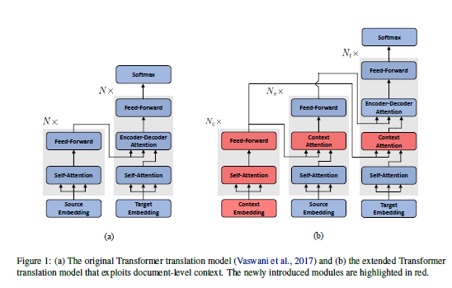
Methodology proposed/implemented in the paper

Slide 43
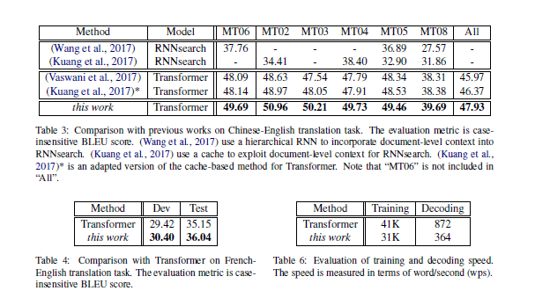
RESULTS:

Slide 44
Merits and Demerits of the proposed method in the paper
MERITS
-Increased capability to capture context
-Small computational overhead: as all newly introduced modules are based on highly parallelizable multi-head attention, there is no significant slowdown in both training and decoding;
-Better use of limited labeled data
DEMERITS
-document-level NMT achieves much worse results than sentence-level NMT (i.e.,36.52 vs. 39.53) when only small-scale document level parallel corpora are available
-yet to further validate the effectiveness of approach on more language pairs.

Slide 45
Discussion
 | Paper 1: | Paper 2: | Paper 3 : | Paper 4: | Paper 5: | Paper 6:
Proposed Method | MT based Hybrid model system for English to kannada translation, where rule-based and example-based methods are combined to obtain accurate results | POS tagger for Kannada sentence translation. Where they have used decision tree based model for tagging /kannada sentences which would help in translation | Using Bert for neural machine translation using baseline model like transformer big and transformer base | MT system in which Rule-Based, Dictionary-Based approaches are applied for English-to-Kannada/Telugu Language Identification and MT | Uses BERT fused model, i.e. extract representations for an I/p sequence, fused with each layer of enc and dec | Considers doc level context rather than sentence level using multi-head self attention
Shortcomings for our use case | text preprocessing methods can be incorporated | No reputed souce for the application in Eng-kannada translation | Doesn’t focus on the other language translation. And the Source containing UNK token gives poor translation. | The semantic structures was not considered.i.e, SOV structure in case of kannada was not considered | No reputed source for applying BERT to Kannada | No reputed souce for the application in Eng-kannada translation
Possible improvements we can implement | Since they built their own bilingual dataset and worked over it. It might not over accurate while testing for other sentences which are not present in the corpus. So this can be improved by NMT model. | As its known that english has SVO structure while kannada SOV structure for translation this need to solved by using morphology of natural language | Implement for english-kannada translation. Make the model still more robust | as its known that english has SVO structure while kannada SOV structure for translation this need to solved by using morphology of natural language | Attempting to apply the methodology for Eng-Kannada translation using better dataset | Check if doc level context improves accuracy

Slide 46
Current Systems
English to Kannada Sentence Translation
Current models over above topic basically deals with rule-based and corpus-based MT methods.
There have been two major approaches among the corpus based MT known as statistics-based and example-based.
All the approaches have their own pros and cons, MT method had tried to select the most accurate models among them and combined to get the hybrid models which give the better results .
Currently two potential approaches i.e., rule-based and example-based models have been combined to built an accurate translator for English to Kannada.
But still this MT(Machine Translation) model has pointed out different structures in the Languages i.e., English has Subject Verb Object (SVO) structure while Kannada has Subject Object Verb (SOV) structure.

Slide 47
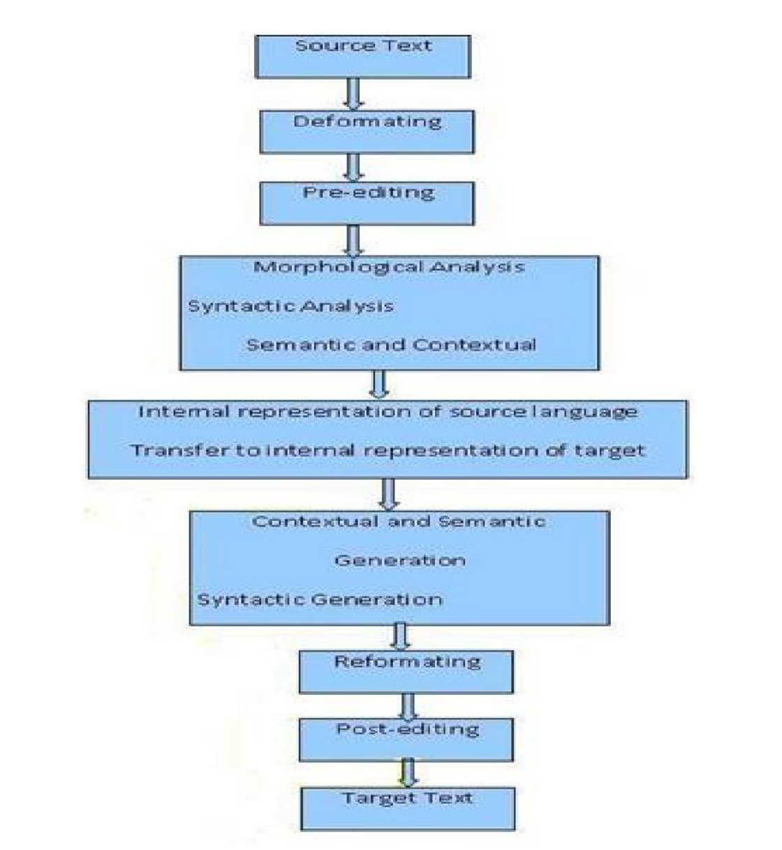
Current Systems
The following figure depicts the current system of MT for English to Kannada sentence.

Slide 48
Novelty/Innovativeness
Implementing the machine translation system using models like pre trained BERT ,Neural machine translation ,as the most research for the translation from english to kannada is mostly involved in statistical approaches.
The current model on the translation from english to kannada gives more accuracy as the corpus size increases. By using models like BERT, Neural machine translation there is not much impact on the corpus size and moreover it depends on how well the model is trained.

Slide 49
Design Constraints
Low resource languages like Kannada presents scarcity in:
i) high quality dataset sources,
ii) research materials and
iii) application of novel methods.
Differing structure of both languages: SVO for Eng and SOV for Kannada

Slide 50
Proposed Methodology / Approach
Basic approach and proposed methodology:
Current system implemented methodology in sentence translation from English to kannada is MT model. Where it combines corpus based(example-based) and rule based method to get an hybrid model which gives the accurate results as increase corpus size.
Our focus:
So our approach is to implement the recent well known model BERT combining with Neural Machine Transition, which has been already implemented for translation from English to German, etc..
So our idea is to implement NMT model over English to Kannada translation , which would give more accurate results than the current system.

Slide 51
Technologies Used
BLEU - for evaluation of Translation
Perplexity - in order to choose best model for translation
Model:-
-> BERT(Bidirectional Encoder Representations from Transformers) model
-> Neural machine translation(NMT) model
Libraries:-
NLTK(natural language toolkit): for preprocessing the data
Tensorflow: to build BERT model and NMT model
Keras
pytorch
BLUE( Bilingual Evaluation Understudy)

Slide 52
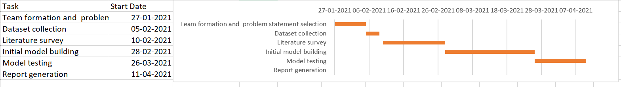
Project Timeline

Slide 53
References
[1]Mallamma.V.Reddy,.Hanumanthappa.M , Kannada and Telugu Native Languages to English Cross Language Information Retrieval" published in (IJCSIT) International Journal of Computer Science and Information Technologies, Vol. 2 (5) , Sep-Oct 2011, page-1876-1880. IISN: 0975-9646.
[2]Mallamma.V.Reddy,.Hanumanthappa.M, “POS Tagger for Kannada Sentence Translation ” published in (IJCSIT) International Journal of Computer Science and Information Technologies, Vol. 1, May-June 2012, ISSN 2278-6856.
[3] Stephane Clinchant, Kweon Woo Jung ,Vassilina Nikoulina “On the use of BERT for Neural Machine Translation” in Proceedings of the 3rd Workshop on Neural Generation and Translation (WNGT 2019),Nov 2019, pages 108–117
[4] Mallamma V.Reddy and M.Hanumanthappa “Indic Language Machine Translation Tool :English to kannada/Telugu” in Proceeding of 100th Science Congress Organized by Indian Science Congress Association (ISCA) - Young Scientists’ Award Programme. 3rd -7th Jan 2013
[5] INCORPORATING BERT INTO NEURAL MACHINE TRANSLATION by Jinhua Zhu1;, Yingce Xia2;, Lijun Wu3, Di He4, Tao Qin2, Wengang Zhou1, Houqiang Li1, Tie-Yan Liu
[6] Improving the Transformer Translation Model with Document-Level Context by
Jiacheng Zhangy, Huanbo Luany, Maosong Suny, FeiFei Zhai, Jingfang Xu, Min Zhangx and Yang Liuyz

Slide 54
Thank You

